Slide 1
Queue
Stores a set of elements in a particular order
Stack principle: FIRST IN FIRST OUT
= FIFO
It means: the first element inserted is the first one to be removed
Example
The first one in line is the first one to be served
cinemark

Slide 2
Queue Applications
Real life examples
Waiting in line
Waiting on hold for tech support
Applications related to Computer Science
Threads
Job scheduling (e.g. Round-Robin algorithm for CPU allocation)

Slide 3
First In First Out
A
B
A
C
B
A
D
C
B
A
rear
front
D
C
B
rear
front
rear
front
rear
front
rear
front

Slide 4
Queue can have 0 to size-1 elements where size is the size of array
Initially when queue is empty, front=0 and rear =-1, ie rear < front.
Insert will be in rear
Deletion will be in front

Slide 5
Insert operation:
Insertion operation performs the following actions.
1. If rear==size-1 i.e queue is full then prints a message that queue is full and no new element can be added to queue.
Otherwise, increments rear by 1 and inserts new element at rear position.

Slide 6
Algorithm:Qinsert
1.[check for overflow]
If rear > size then
print “Queue Overflow”
return
2. otherwise
[increment rear]
rear=rear+1
3. [insert the element into queue]

Slide 7
Q[rear]=item
4.return

Slide 8
Deletion operations:
Deletion operation performs following actions.
1. if the queue is empty which is given by front>rear, then prints a message that no deletion is possible.
Otherwise, retrieves the front element and then increments front by 1.

Slide 9
Algorithm: Qdelete
Procedure qdelete(Q,front,rear)
1.[Check for underflow]
If front > rear
print “Queue underflow”
2. Otherwise, [Retrieve element to be deleted]
item = Q[front]
[when there is only single element in queue]

Slide 10
Step 3: if front = =rear then
begin
front =0
rear=-1
end
goto step 5
Step 4: front =front+1
Step 5: return item

Slide 11
Queus are often used in simulation of real system, as experimenting with real time systems is expensive or dangerous.
Queues are used in BFS
In multiprogramming system, different programs are put in queue and are executed one after another in their respective time slots.

Slide 12
Different process may request the same resource, in such case resource requests are queued and serviced one by one.

Slide 13
Circular Queue
Circular queue are implemented sequentially using array, 0 to MAX-1 elements can be stored in circular queue. Where is the size of array used.
Initially when cqueue is empty, then front = 0 and rear=-1

Slide 14
In two situations cqueue will be full.
A. when front==0 and rear == MAX-1
B. when front=rear+1 and front=0 and rear != -1
Other wise, finds next rear location by statement
Rear =(rear+1)%MAX

Slide 15
Insertion into a circular queue
Procedure CQinsert(CQ,max,front,rear,item)
1.[check for overflow]
If(rear==max-1 and front =0) OR (front==rear+1 and front≠ 0 and rear ≠ 0)
print( “Cqueue full”)
return
2.[find next rear location]
rear=(rear+1)%max

Slide 16
CQ[rear]=item
return

Slide 17
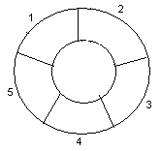
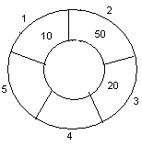
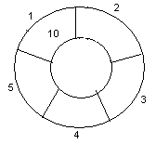
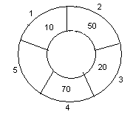
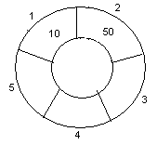
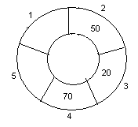
Example: Consider the following circular queue with N = 5.
1. Initially, Rear = 0, Front = 0.
4. Insert 20, Rear = 3, Front = 0.
Front
Rear
2. Insert 10, Rear = 1, Front = 1.
5. Insert 70, Rear = 4, Front = 1.
Rear
Front
Front
Rear
3. Insert 50, Rear = 2, Front = 1.
6. Delete front, Rear = 4, Front = 2.
Front
Rear
Front
Rear
17

Slide 18
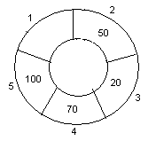
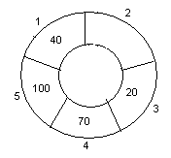
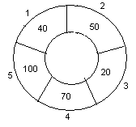
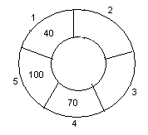
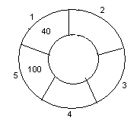
7. Insert 100, Rear = 5, Front = 2.
10. Delete front, Rear = 1, Front = 3.
Front
Rear
Front
Rear
8. Insert 40, Rear = 1, Front = 2.
11. Delete front, Rear = 1, Front = 4.
Rear
Rear
Front
Front
9. Insert 140, Rear = 1, Front = 2.
As Front = Rear + 1, so Queue overflow.
12. Delete front, Rear = 1, Front = 5.
Rear
Rear
Front
Front
18

Slide 19
Deletion
Deletion performs the following actions:
A. It checks if the queue is empty by the condition front==0 and rear==-1, which is the initial condition, of empty queue. Its true prints queue underflow.
B. It checks if there is only one item in the queue by condition front==rear, it there is only one element then initializes front =0 and rear=-1
Otherwise increments front by 1
Front=(front+1)% MAX and returns deleted item.

Slide 20
Cqueue Deletion
1.[check for underflow]
if front==0 and rear==-1
print “Cqueue underflow”
return
2.[check if there is only one element in Cqueue]
if front==rear then
begin

Slide 21
item=CQ[front]
front=0
rear=-1
return item
end
item=CQ[front]
front=(front +1)%Max
return(item)
end

Slide 22
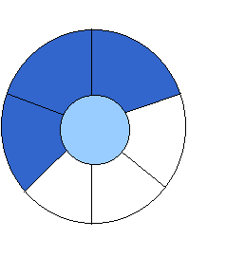
Implementation 2:
Wrapped Configuration
EMPTY QUEUE
[2]
[3] [2] [3]
J2
J3
[1] [4] [1] [4]
J1
[0] [5] [0] [5]
front = 0 front = 0
rear = -1 rear = 3
Can be seen as a circular queue

Slide 23
Algorithm Analysis
enqueue O(?)
dequeue O(?)
size O(?)
isEmpty O(?)
isFull O(?)
What if I want the first element to be always at Q[0] ?

